Slide 1
Fundamental Programming Structures in JAVA
Objects and classes

Slide 2
Objectives
To describe objects and classes and use classes to model objects.
To demonstrate how to define classes and create objects.
To create objects using constructors.
To access objects via object reference variables.
To define a reference variable using a reference type.
To access an object’s data and methods using the object member access operator (.).
To distinguish between object reference variables and primitive data type variables.
To distinguish between instance and static variables and methods.

Slide 3
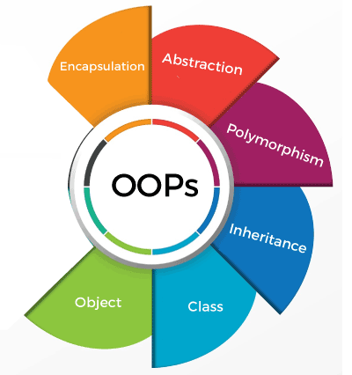
Object-Oriented Programming Terminologies

Slide 4
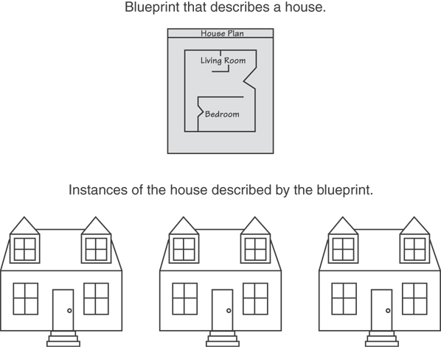
Classes and Objects

Slide 5
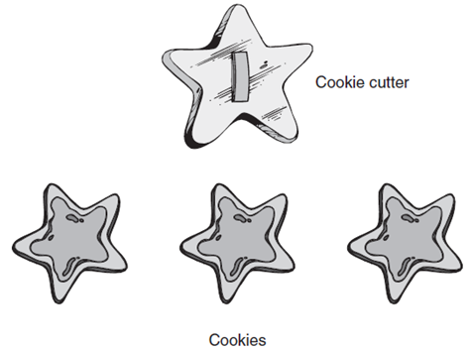
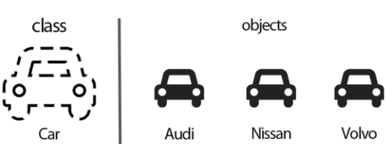
Classes and Objects

Slide 6
Classes and Objects
Class: code that specifies the data attributes and methods of a particular type of object
Similar to a blueprint of a house or a cookie cutter.
Object : an instance created from a class
Similar to a specific house built according to the blueprint or a specific cookie.
There can be many instances of one class.

Slide 7
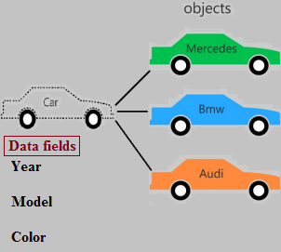
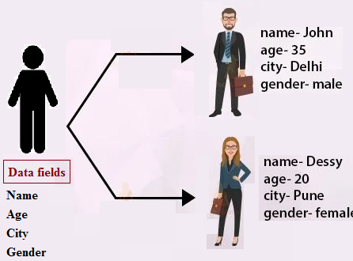
Classes and Objects
Classes are user-defined (programmer-defined) types.
attributes (data members)
methods or behaviors: (member methods)

Slide 8
Classes in Java
Classes are constructs that define objects of the same type. A Java class uses variables to define data fields and methods to define behaviors. Additionally, a class provides a special type of methods, known as constructors, which are invoked to construct objects from the class.
Class : is a group of objects that share common properties and behavior.
For example, we can consider a car as a class that has characteristics like steering wheels, seats, brakes, etc. And its behavior is mobility. But we can say Honda City has a reg. number 4654 is an ‘object’ that belongs to the class ‘car’. It was a brief description of objects and classes. Now we will understand the Java class in detail.

Slide 9
Class Diagram
Class Name
Attribute₁ name: type
Attribute₂ name: type
.
.
.
Attribute_{n} name: type
Each class has both a state (data fields ) and behavior (Methods) :
Data fields defines the object attributes.
A class
diagram
List of methods
Methods define what the object does.
(we will explain it later)

Slide 10
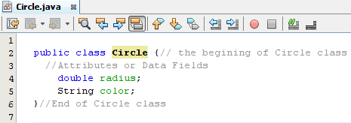
Class Template
Example 1: Design the class (Circle) that has (radius), (color) as its attributes:
Circle
radius: double
Color: String
Class name
Design Phase
This class should be saved as (Circle.java).
Implementation (programming) Phase using java
A class allows the programmer to define all the properties that internally define the state of an object..

Slide 11
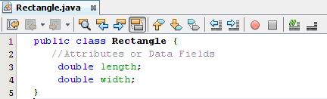
Class Template
Example 2: Design the class (Rectangle) that has (length, width) as its attributes.
Design Phase
Implementation (programming) Phase using java
Rectangle
length: double
width: double

Slide 12
Class Syntax
The general syntax for defining a class is:
Question: Design a class (Person) that has (name: String, age: int, length: double, salary: int, job: String, weight: double, and gender: char) as its attributes.
modifier(s) class ClassIdentifier modifier(s) { classMembers }

Slide 13
Writing a Class, (Step by Step)
Class name goes here
Rectangle
Attributes are listed here
width : double
length : double
Unified Modeling Language (UML) provides a set of standard diagrams for graphically depicting object-oriented systems.
+ getArea() : double
+ getPerimeter() :double
+ printDetails(String shapeName): void
+ isSquare():boolean
Methods are listed here

Slide 14
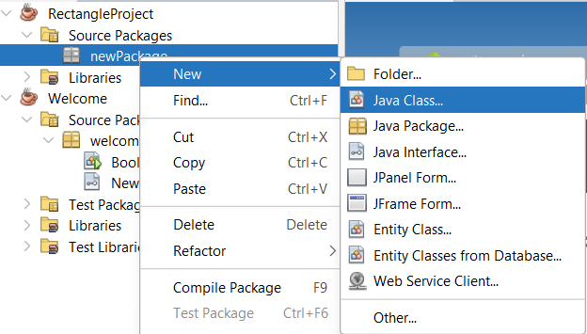
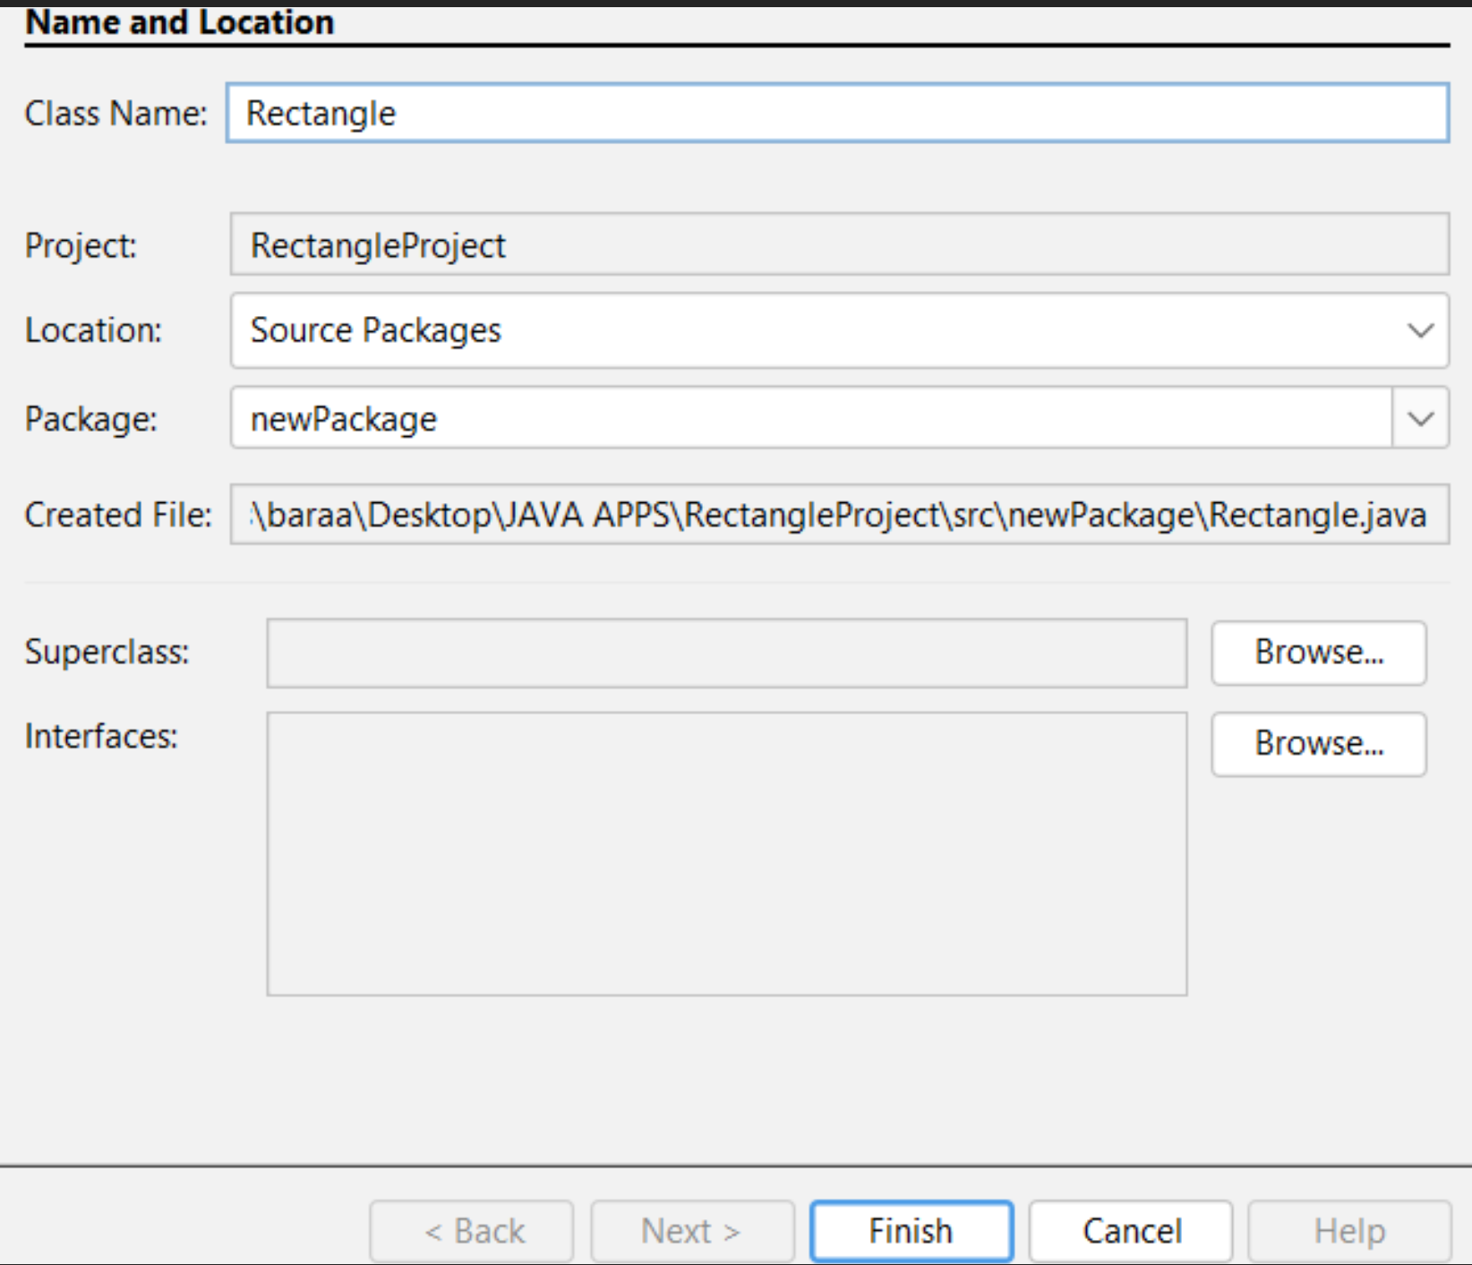
Cont. Writing a Class
Create the Rectangle class:
Create a new project with an appropriate name.
Create a new package name it new package.
Finally create the class Rectangle in the newly created package.

Slide 15
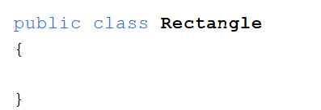
Cont. Writing a Class
A Rectangle class will have the following data fields:
length, The length field will hold the rectangle’s length.
width, The width field will hold the rectangle’s width.
public class Rectangle
{
double length;
double width;
}

Slide 16
Instance Variables
The data fields length and width in the rectangle class are known as instance variables.
An Instance variable is tied to a specific instance of the class; it is not shared among objects of the same class
Rectangle object 1
Data fields:
width is 10
length is 7
Class Name: Rectangle
Data Field:
width
length
Methods:
getArea()
getPerimeter()
Rectangle object 2
Data fields:
width is 15
Length is 10

Slide 17
Writing a Class, Step by Step
The Rectangle class will also have the following methods:
getArea() will return the area of the rectangle, which is the result of the object’s length multiplied by its width.
getPerimeter() will return the Perimeter of the rectangle, which is the result of the object’s 2*length +2 *width.

Slide 18
Writing a Class, Step by Step , cont..
The Rectangle class will also have the following methods:
printDetails(String shapeName) will print the details of the rectangle such as length , width , area and shape name.
isSquare() will check wether the rectangle is a square or not

Slide 19
Instance Methods
Method Declarations:
A method is a collection of statements that are grouped together to perform an operation.

Slide 20
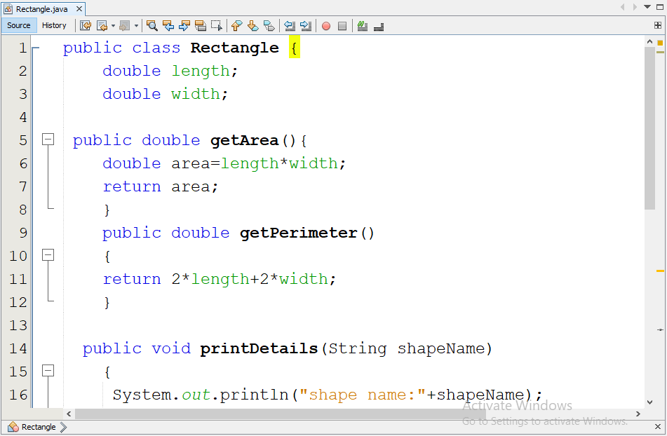
Writing a Class, Step by Step
Data Fields
Instance Methods

Slide 21
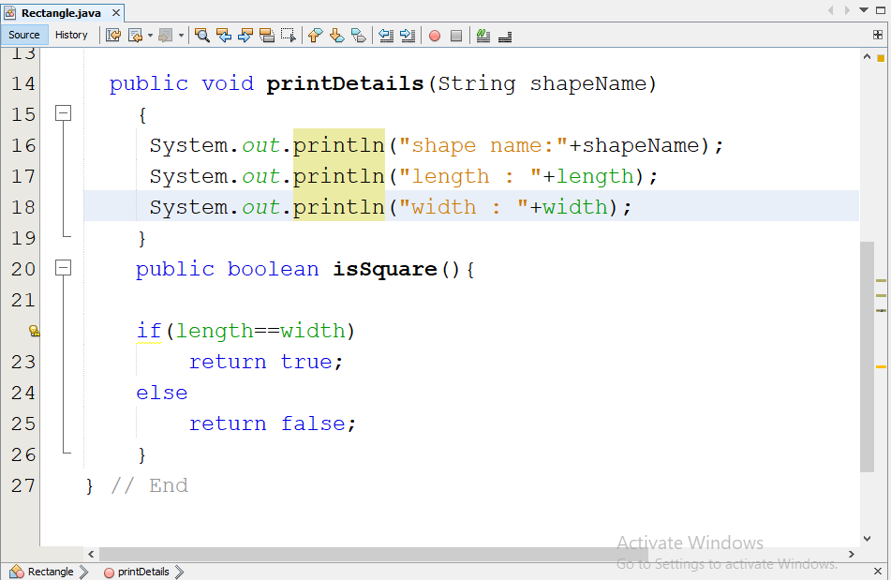
Writing a Class, Step by Step
Instance Methods

Slide 22
Object Instantiation (Creating Object)
Rectangle box = new Rectangle ();
class name
box reference variable
Rectangle object
The box variable holds the address (Reference) of the Rectangle object.
length:
0.0
address
width:
0.0
box

Slide 23
Trace Method Invocation
Create an object

Slide 24
Trace Method Invocation
width is now 10.0

Slide 25
Trace Method Invocation
length is now 5.0

Slide 26
Trace Method Invocation
Invoke getArea()

Slide 27
Trace Method Invocation
Declare variable area

Slide 28
Trace Method Invocation
Compute the area

Slide 29
Trace Method Invocation
Compute the area and assign the result in area

Slide 30
Trace Method Invocation
return the area, which is 50.0

Slide 31
Constructors
Classes can have special methods called constructors.
A constructor is a method that is automatically called when an object is created.
Constructors are used to perform operations at the time an object is created.
Constructors typically initialize instance fields and perform other object initialization tasks.

Slide 32
Constructors
Constructors have a few special properties that set them apart from normal methods.
Constructors have the same name as the class.
Constructors have no return type (not even void).
Constructors may not return any values.
Constructors are typically public.

Slide 33
The Default Constructor
When an object is created, its constructor is always called.
If you do not write a constructor, Java provides one when the class is compiled. The constructor that Java provides is known as the default constructor.
It sets all of the object’s numeric fields to 0.
It sets all of the object’s boolean fields to false.
It sets all of the object’s reference variables to the special value null.
The default constructor is a constructor with no parameters, used to initialize an object in a default configuration.
The only time that Java provides a default constructor is when you do not write any constructor for a class.
A default constructor is not provided by Java if a constructor is already written.

Slide 34
Writing Your Own No-Arg Constructor
A constructor that does not accept arguments is known as a no-arg constructor.
The default constructor (provided by Java) is a no-arg constructor.
If you include even one constructor in your class, Java will not provide this default constructor
If you include any constructors in your class, be sure to provide your own no-argument constructor as well
We can write our own no-arg constructor
public Rectangle()
{
length = 1.0;
width = 1.0;
}

Slide 35
Parametrized Constructor
Constructor like other methods can be overloaded.
The constructor that takes parameters named a parametrized constructor.
public Rectangle(double len, double w)
{ length = len;
width = w;
}

Slide 36
Parametrized Constructor
What would happen when we execute the following calls?
The first call would use the no-arg constructor and box1 would have a length of 1.0 and width of 1.0.
The second call would use the original constructor and box2 would have a length of 5.0 and a width of 10.0.
Rectangle box1 = new Rectangle();
Rectangle box2 = new Rectangle(5.0, 10.0);

Slide 37
Summarization Constructors
Constructors: are a special type of methods which have exactly the same name as the class and they are used to construct objects of that class.
You can write as many constructors as required in each class, each has different assignments (Overloading).
Overloading: is when two or more methods have the same name but different parameters within the same class.
Constructors are example of overloading. All the constructors of a specific class have the same name (the class name), but the list of parameters should be different between each others.

Slide 38
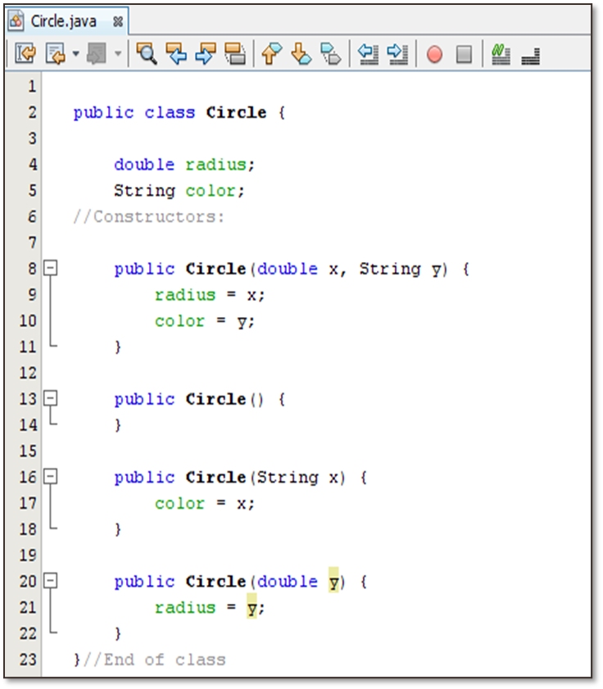
Constructors Types
Parameterized constructor
No argument constructor
One parameter constructor

Slide 39
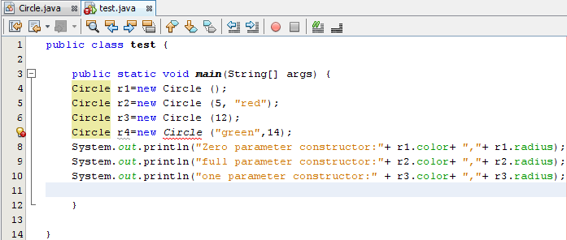
Constructors Types
Code and Error explanation in next slides

Slide 40
Constructors Types: Explanation
Line 4: creates an object (r1) from the class circle using the constructor without parameters in line 13 in the circle class. Note that there no default constructor in the class now, since there is at least one user defined constructor written.
(r1) now has radius = 0.0 and color = null.
The code of this constructor can be left empty ({}) so the default values are going to be assigned to the attributes. Instead of this, you can assign any required values to the attributes.
Line 5: creates an object (r2) from the class circle using the constructor with full parameters in line 8 in the circle class, passing the values 5 and "red" to be the values of radius and color attributes respectively.

Slide 41
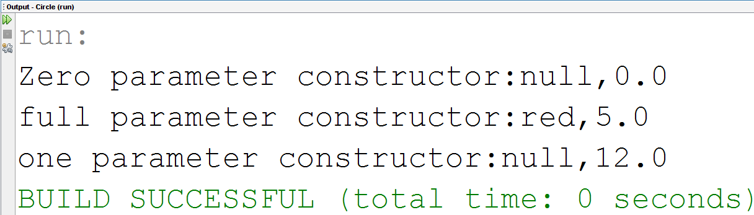
Constructors Types: Explanation
Line 6 : creates an object (r3) from the class circle using the constructor with one parameter in line 16 in the circle class, passing the values 12 to be the value of radius.
The constructors in line (7) generates error, since there are no constructors in the class matching the given parameters.

Slide 42
Example: Circle Class with Constructors

Slide 43
Trace Code
Memory
Declare myCircle
myCircle declared In the memory
Circle myCircle = new Circle(5.0);
Circle yourCircle = new Circle();
yourCircle.radius = 100;
myCircle
no value

Slide 44
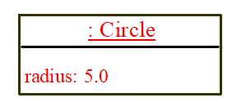
Trace Code
Memory
Assign object reference to myCircle
Circle myCircle = new Circle(5.0);
Circle yourCircle = new Circle();
yourCircle.radius = 100;
myCircle
Reference value

Slide 45
Trace Code
Memory
New circle created
Circle myCircle = new Circle(5.0);
Circle yourCircle = new Circle();
yourCircle.radius = 100;
myCircle
Radius = 5.0

Slide 46
Trace Code
Memory
Declare yourCircle
yourCircle declared In the memory
Circle myCircle = new Circle(5.0);
Circle yourCircle = new Circle();
yourCircle.radius = 100;
yourCircle
no value

Slide 47
Trace Code
Memory
Assign object reference to yourCircle
myCircle
Circle myCircle = new Circle(5.0);
Circle yourCircle = new Circle();
yourCircle.radius = 100;
yourCircle
Reference value

Slide 48
Trace Code
Memory
Change radius value in yourCircle
myCircle
Circle myCircle = new Circle(5.0);
Circle yourCircle = new Circle();
yourCircle.radius = 100;
yourCircle
Reference value

Slide 49
Trace Code
Memory
Assign object reference to yourCircle
myCircle
Circle myCircle = new Circle(5.0);
Circle yourCircle = new Circle();
yourCircle.radius = 100;
yourCircle
Reference value

Slide 50
Exercise
Design a class named (Book) that has the following members:
Two instance variables number of type int and name of type String
Three different constructors.
display( ) method to print the details of the book .
In the main class , create three objects of type (Book) using different constructors to represent three books and print the details for each book.

Slide 51
References
[1] Introduction to Java Programming, Comprehensive Version, Student Value Edition, Daniel Liang, 12th Edition, Pearson 2019
lecture Notes :edugate.asu.edu.jo.
lecture Videos : YouTube channel.
Lab manual ???

